Slide 1
Google Product Inventory
•Yash Zaveri – 002208067- Command Design Pattern and Frontend
•Viral Suchak - 002301580 - Strategy and factory Design Pattern
•Omkar Vaity – 002836207 - State and Singleton Design Pattern
•Christ Rodrigues – 002727863 - Facade Design Pattern and Frontend
•Kevin Rodrigues – 002615215 - Observer Design Pattern and Frontend

Slide 2
Libraries/ Frameworks
FRONTEND – REACT AND BOOTSTRAP
DATABASE – MYSQL
DATABASE CONNECTIVITY – HIBERNATE
BACKEND – JAVA EE, SPRING, APACHE TOMCAT

Slide 3
IMPLEMENTATION OF DESIGN PATTERNS
Singleton Pattern – To instantiate the model objects
Abstract Factory – To Obtain the objects for UDP
Decorator Pattern– Creating the final purchase order that includes the merchandise
State pattern – To implement strategies for designated roles
Façade pattern – To generate a PDF and send notifications
Command pattern – USED To facilitate communication between the client and the server
Strategy pattern – USED To alter the approach for crud operations while they are running
Observer pattern – To inform all buyers who have registered for the new product

Slide 4
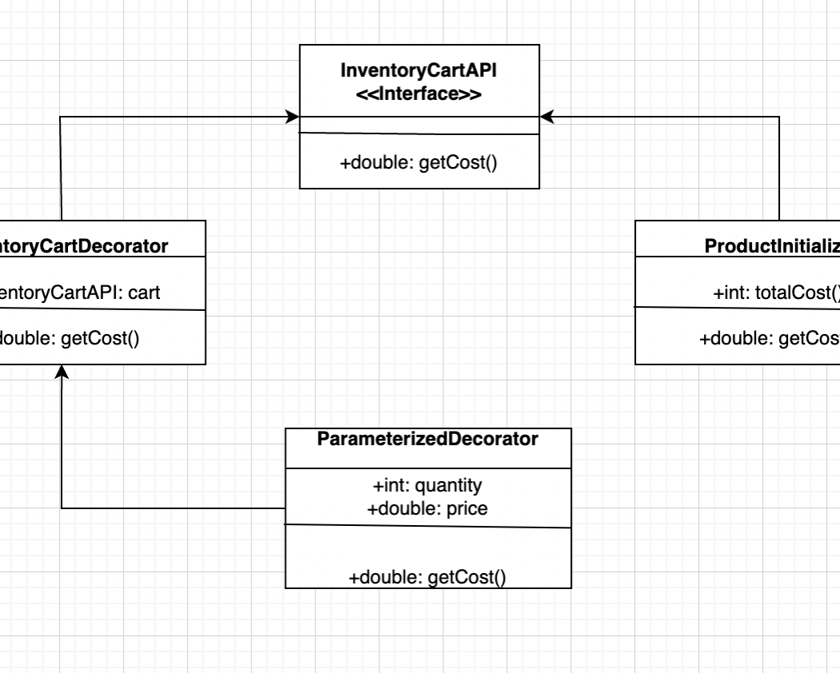
UML – Decorator Pattern
Decorator Pattern is implemented to add products for the creation of new purchase order

Slide 5
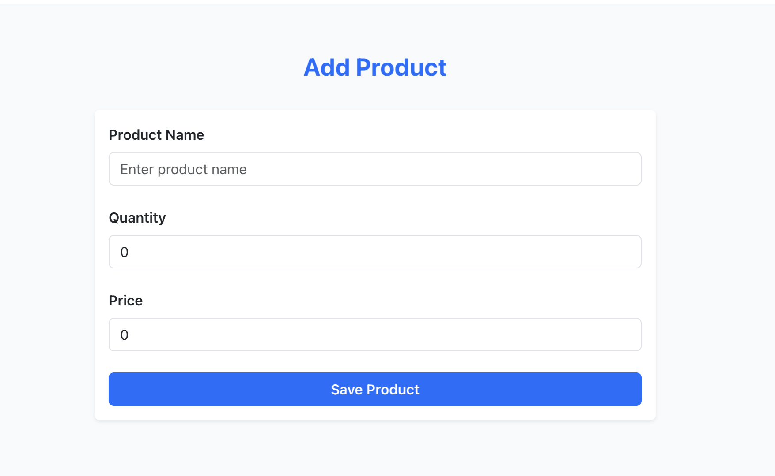
Decorator Pattern

Slide 6
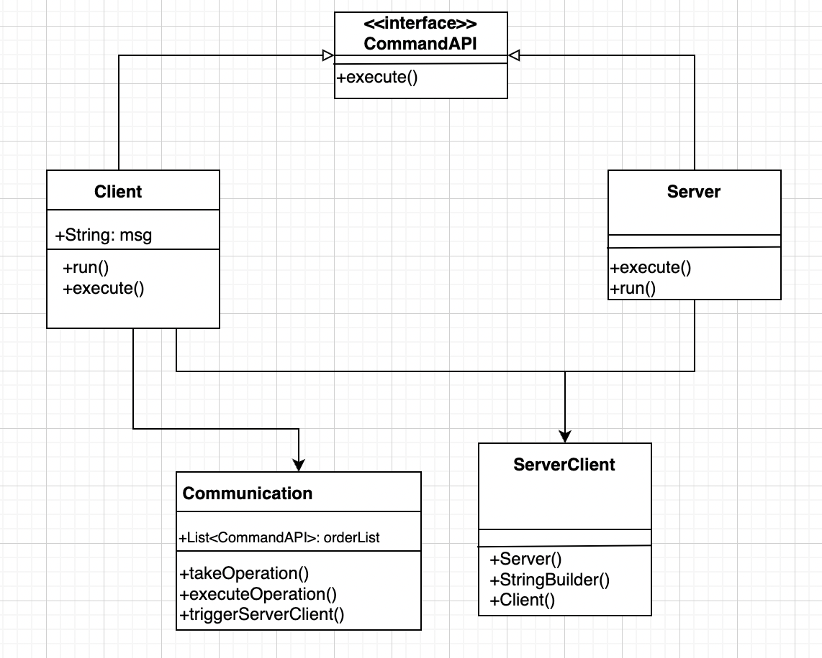
UML – Command Pattern
Through the uml-command pattern, the server sends an alert, when the quantity is low

Slide 7
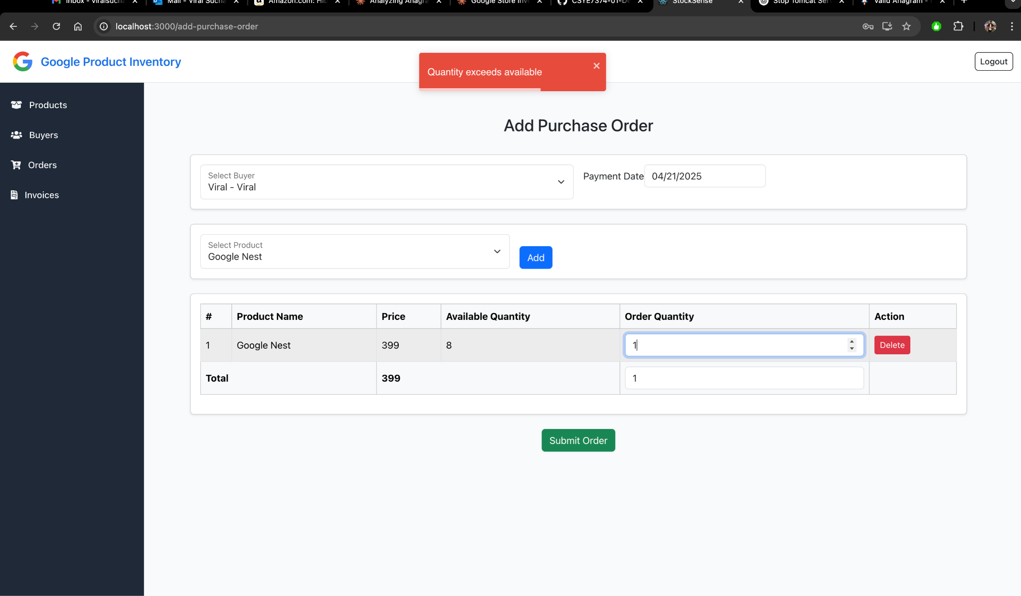
Command Pattern

Slide 8
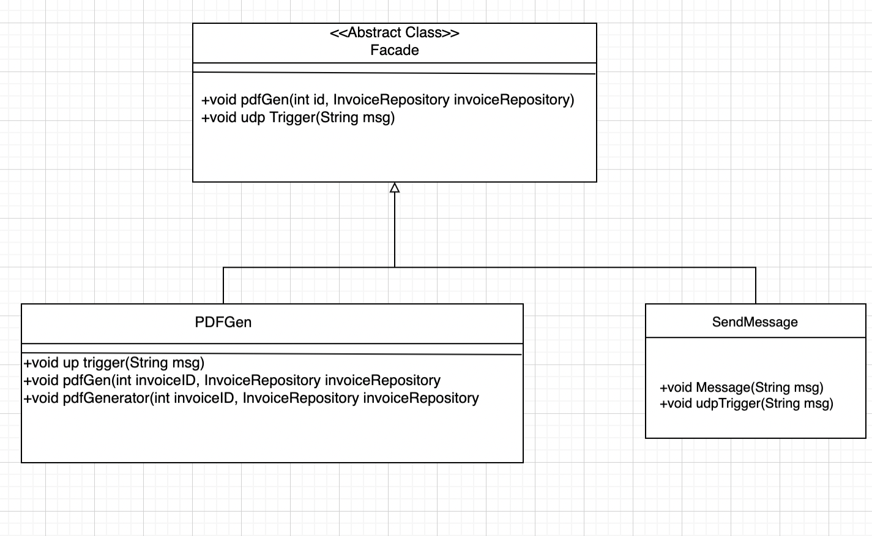
UML – Facade Pattern
Façade pattern is executed here, to generate a pdf of the transaction, once the payment is done

Slide 9
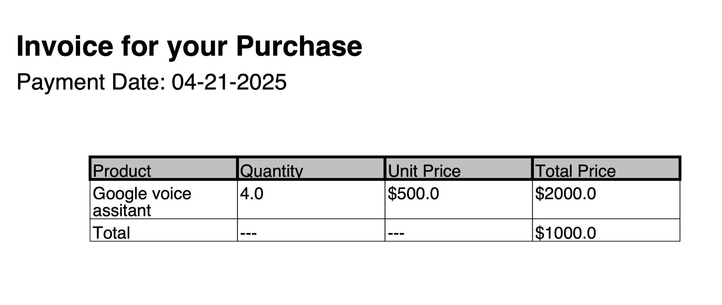
Facade Pattern

Slide 10
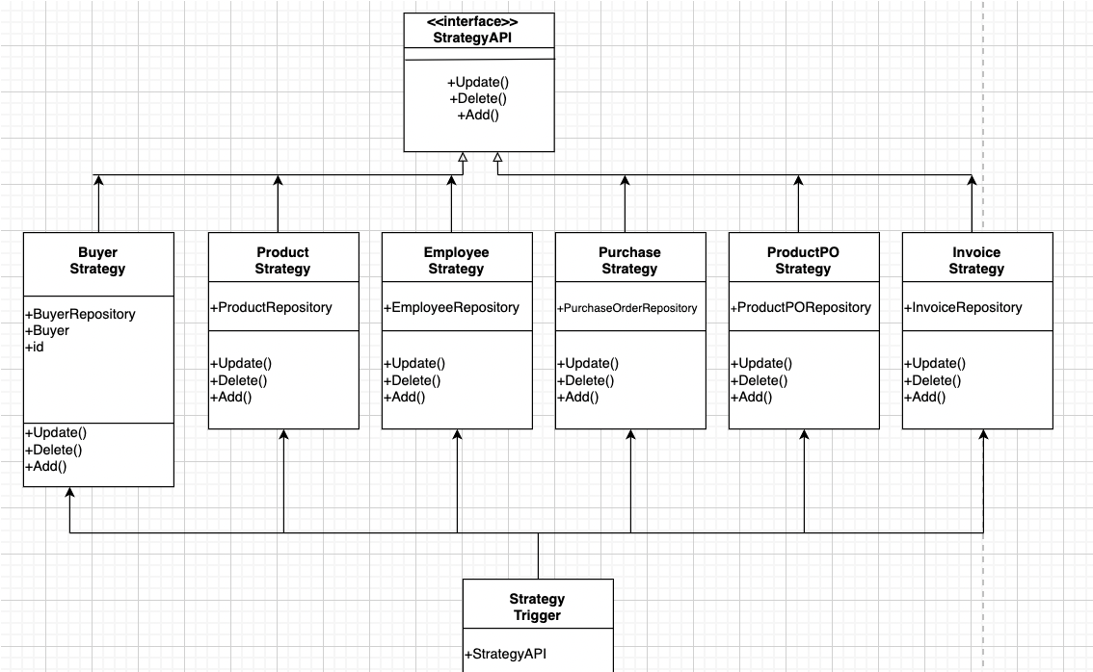
UML – Strategy Pattern
Strategy Pattern is implemented for carrying out CRUD operations on all entities

Slide 11
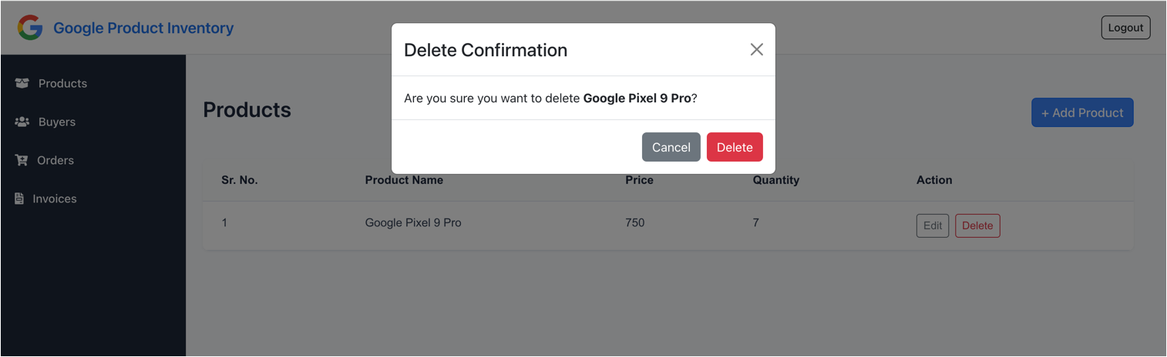
Strategy Pattern

Slide 12
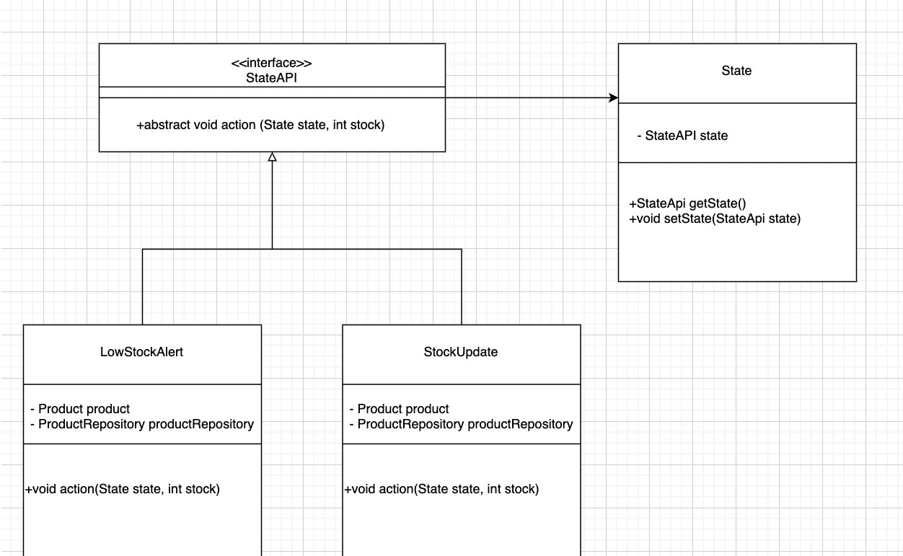
UML – State Pattern
State Pattern allows an object to alter its behavior when its internal state changes by delegating the behavior to separate state classes.

Slide 13
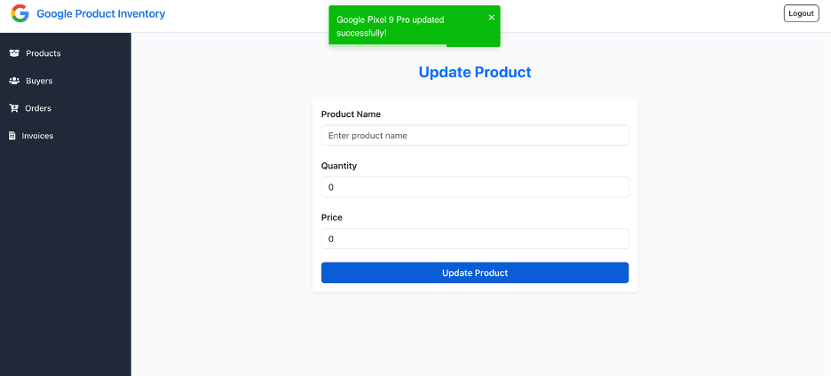
StatePattern

Slide 14
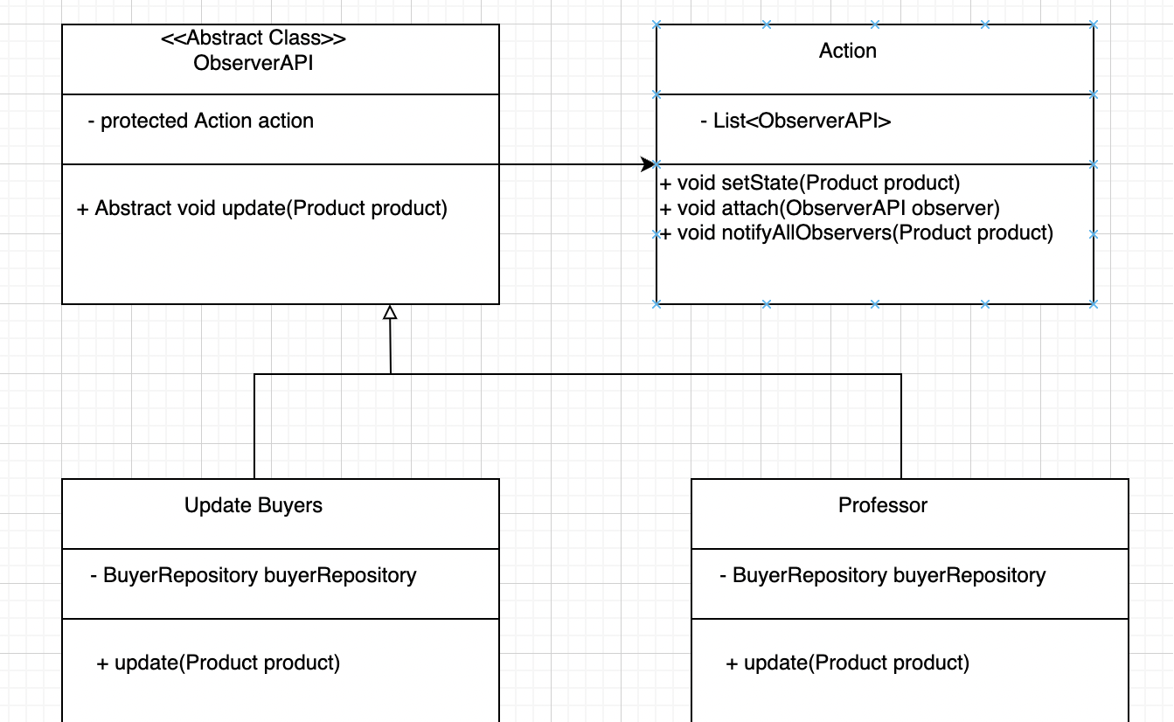
UML – Observer Pattern
Through UML – observer pattern, we can send the Notification of new products to all the buyers

Slide 15
Future enhancements
SENDING EMAIL AND PHONE NOTIFICATION TO ALL PURCHASERS
ACCEPTING ONLINE PAYMENTS
GENERATING REAL-TIME CHAT SYSTEMS FOR THE CLIENTS

Slide 16
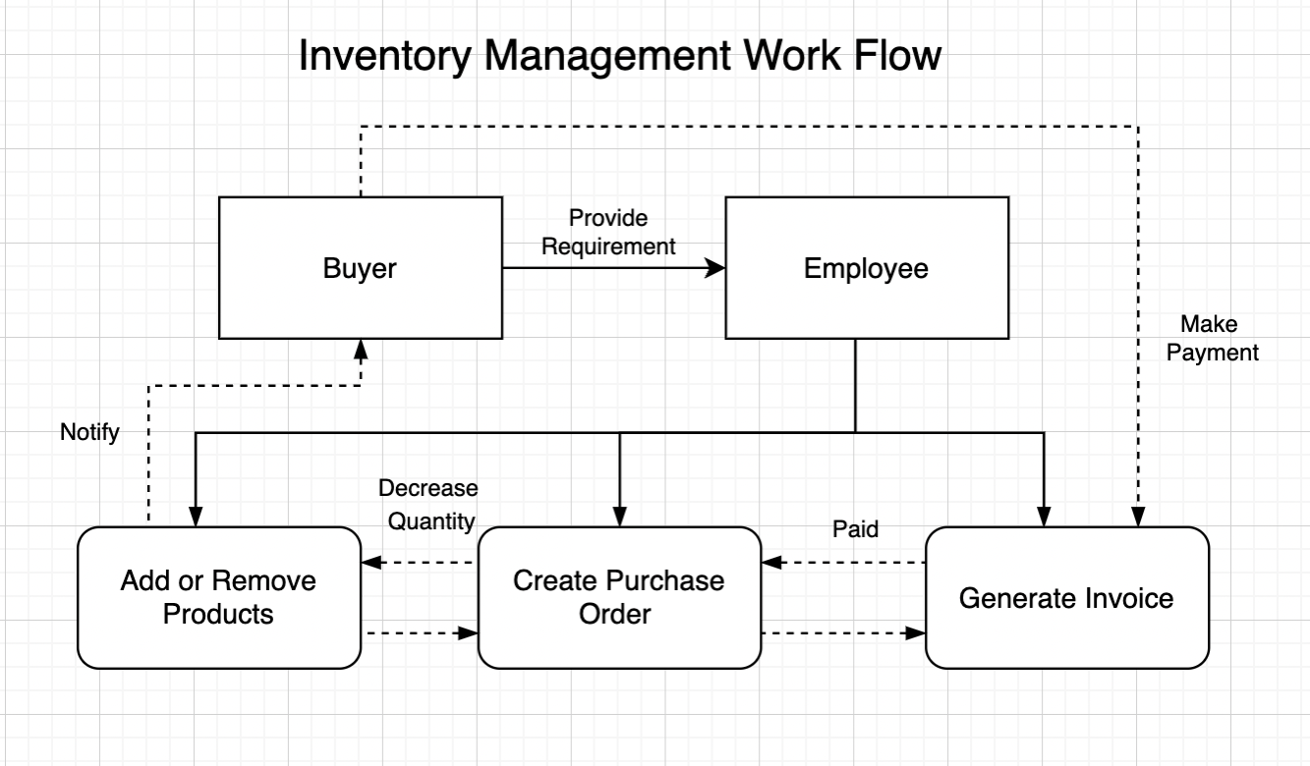
Workflow of Inventory Management

Slide 17
Thank you!

